Slide 1


STATISTICS
Session 3: Probability & Statistics

Slide 2
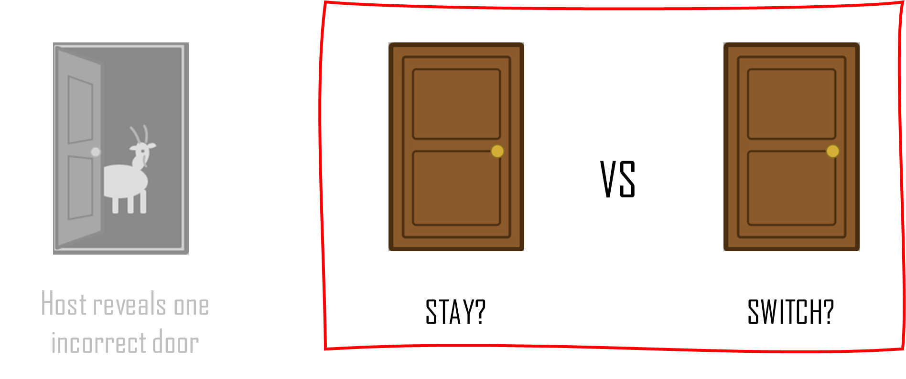
The Monty Hall Problem
Suppose the contestants on a game show are given the choice of three doors: Behind one door is a car; behind the others, goats. After a contestant picks a door, the host, who knows what’s behind all the doors, opens one of the unchosen doors, which reveals a goat. He then says to the contestant, “Do you want to switch to the other unopened door, or stay with your current choice?”
Is it to the contestant’s advantage to make the switch?

Slide 3
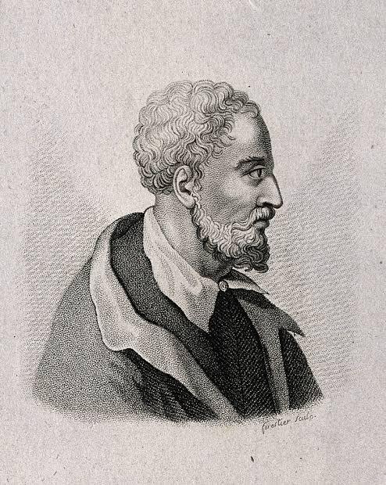
Cardano & the Sample Space
Mathematics
Gave the first algebraic solutions for cubic and quartic equations
Introduced foundation concepts of complex numbers
Physics and Engineering
Invented the universal joint used to transmit rotary motion
Described and improved the three-ring concentric gimbal to keep compasses and gyroscopes level
Contributed to early combination lock designs and hypocycloid "Cardano circles" used in high-speed printing presses
Medicine and Science
Wrote the first clinical description of typhus fever
Authored dozens of medical papers

Slide 4
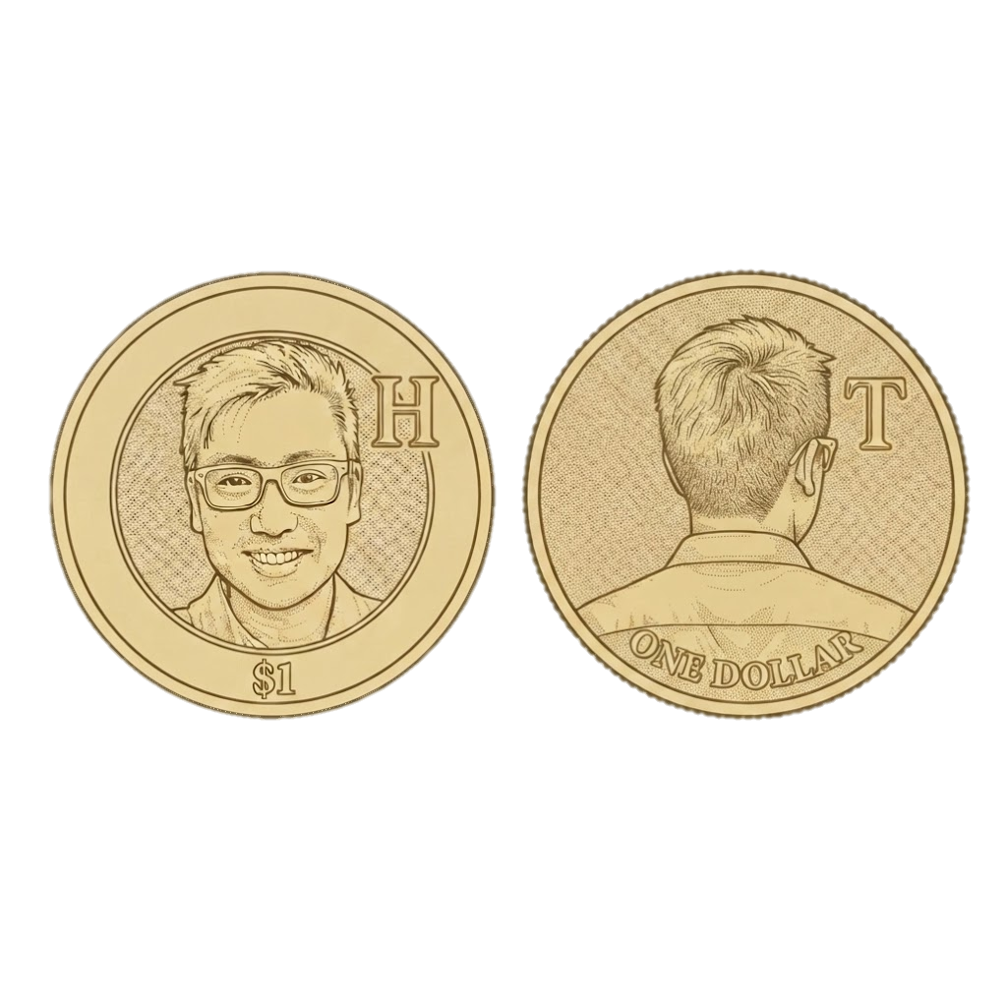
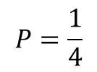
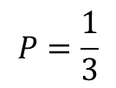
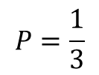
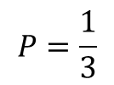
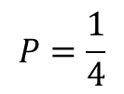
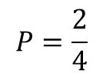
Cardano & the Sample Space
N of heads | Outcomes
0
1
2
N of heads | Outcomes
0
1
2
$$P=\frac{1}{3}$$
$$P=\frac{1}{4}$$
$$P=\frac{1}{3}$$
$$P=\frac{2}{4}$$
$$P=\frac{1}{3}$$
$$P=\frac{1}{4}$$

Slide 5
Sample Space Practice Questions
Suppose a family has two children, and suppose, for simplicity, that each child is equally likely to be a boy or a girl. What is the probability that both children are girls?
Suppose a family has two children, and suppose, for simplicity, that each child is equally likely to be a boy or a girl. What is the probability that at least one of them is a girl?
Suppose a family has two children, and that at least one of them is a girl. And suppose, for simplicity, that each child is equally likely to be a boy or a girl. What is the probability that both children are girls?
Suppose a family has two children, and that the first one is a girl. And suppose, for simplicity, that each child is equally likely to be a boy or a girl. What is the probability that both children are girls?

Slide 6
Solving The Monty Hall Problem
If STAY
If SWITCH
C
C
C
G₁
C
G₁
G₂
G₂
C
C
G₁
G₁
G₁
G₁
G₂
G₂
C
C
G₂
G₁
G₂
G₁
G₂
G₂

Slide 7
Solving The Monty Hall Problem
If STAY
If SWITCH
C
C
C
G₁
C
G₁
G₂
G₂
C
C
G₁
G₁
G₁
G₁
G₂
G₂
C
C
G₂
G₁
G₂
G₁
G₂
G₂

Slide 8
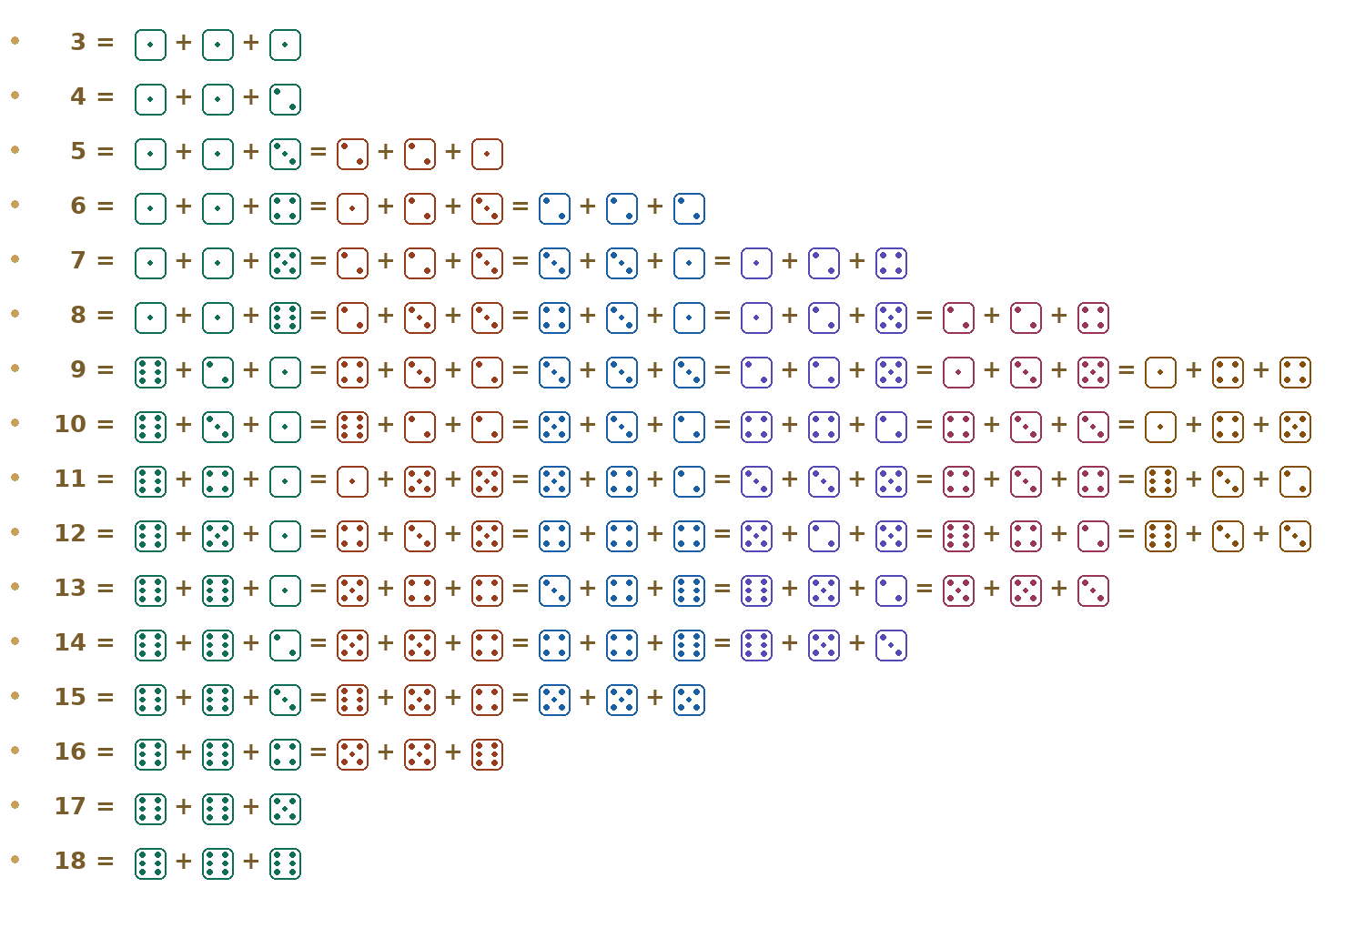
Galileo and Counting
“When you throw 3 dice (and sum the outcomes), why does the number 10 appear more frequently than the number 9?”

Slide 9
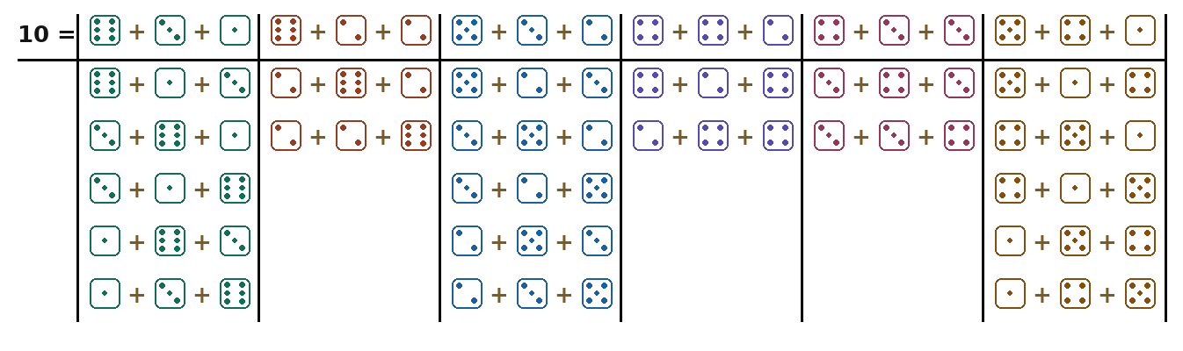
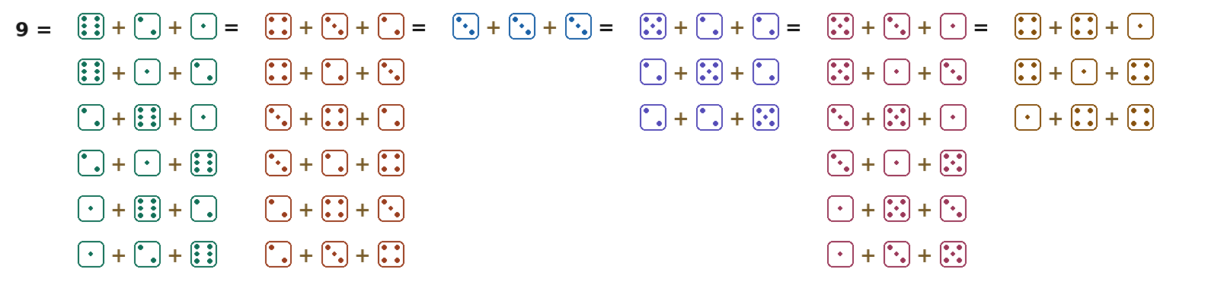
Galileo and Counting
27
25

Slide 10

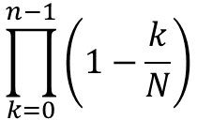
Canadian Lottery Example
In the early 2000s the Canadian lottery had 500 cars to award to random subscribers. They used each person’s subscriber number as a sampling frame and had approximately 2.4 million numbers. To their embarrassment, the same number cam up twice!
What is the probability of that happening?
Let N = 2,400,000 and n = 500
Assume sampling with replacement
P(at least one repeat) = 1 – P(no repeats)
P(at least one repeat) = 1 – $\frac{N}{N}×$ $\frac{N−1}{N}×\frac{N−2}{N}×…\frac{N−(n−1)}{N}$
P(at least one repeat) =
$$\prod_{k=0}^{n−1}{\left(1−\frac{k}{N}\right)}$$
P(at least one repeat) =
$$0.0507 (\sim 5\%)$$

Slide 11
Practice Question
How many people do you need in a room for there to be a 50% chance that two share a birthday?

Slide 12
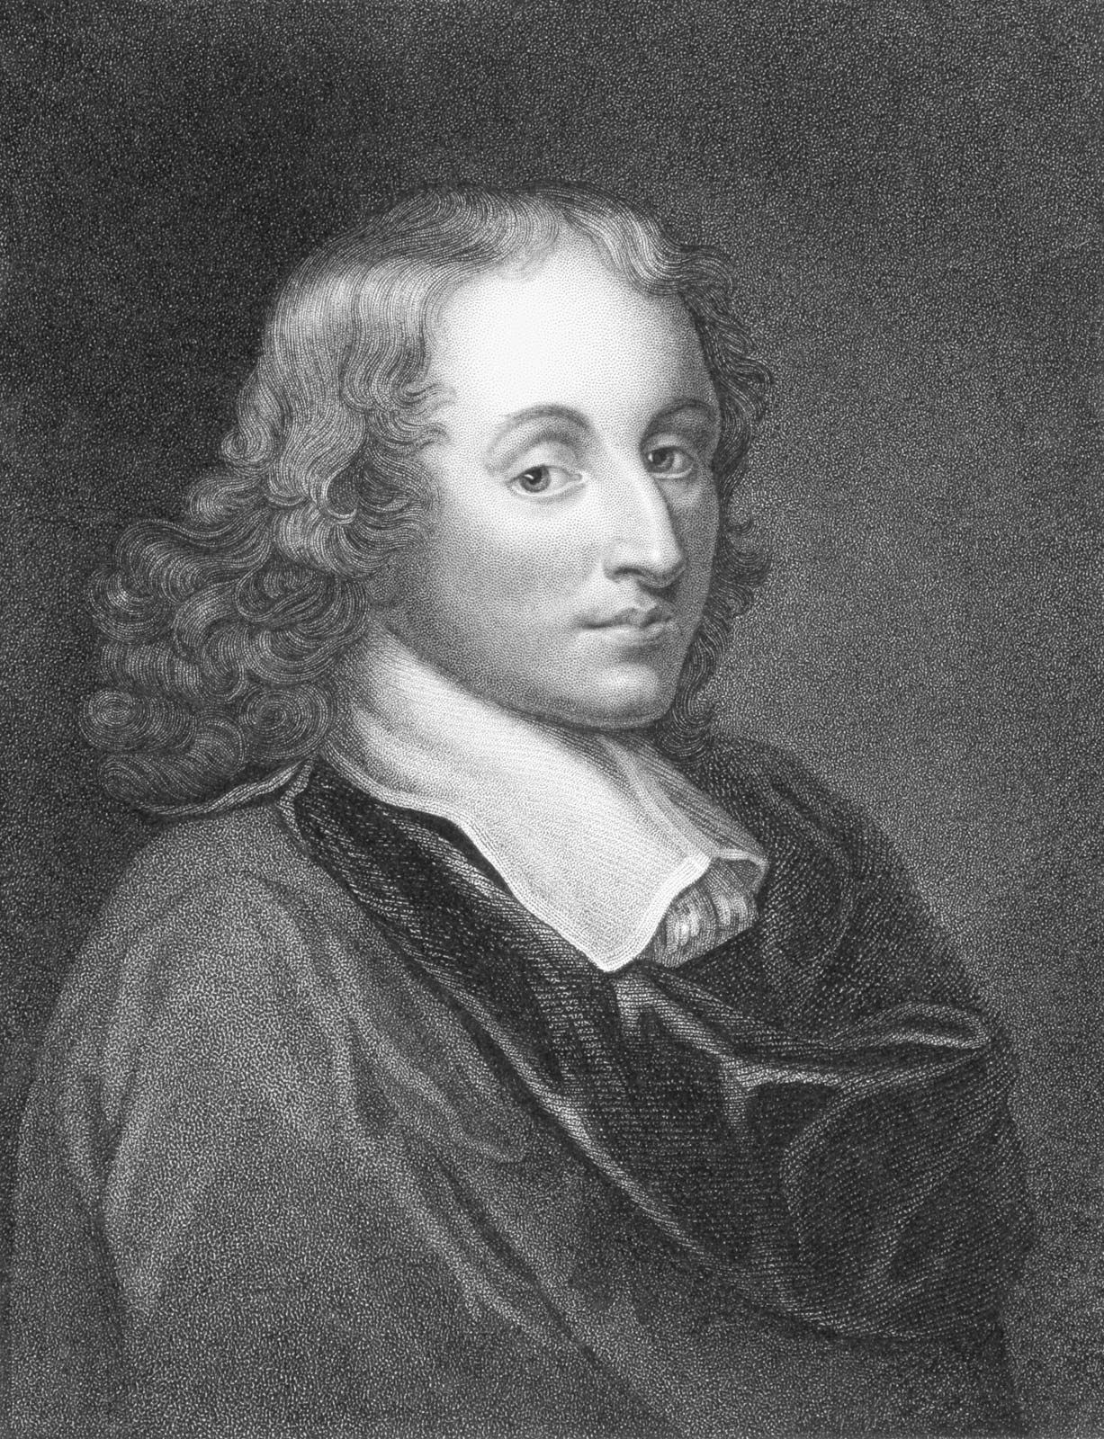
Blaise Pascal
Blaise Pascal (1623 – 1662)
Similar to Galileo, Pascal is remembered for many contributions that are relevant in the modern age:
The Pascline (mechanical calculator and design for modern calculators)
Atmospheric Pressure
The standard unit of Pressure – the pascal (Pa)
Pascal’s principle, which lead to the invention of the hydraulic press
Pascal’s Triangle (used in algebra and combinatorics)
Towards a working theory of probability

Slide 13
The Problem of Points
Imagine two players are playing a coin-flipping game. We will call them Harry and Tom. Harry scores a point whenever the coin lands Heads (H). Tom scores a point whenever the coin lands Tails (T). The first player to reach 3 points wins the game and takes the prize of $100.
Now suppose the first three flips are: H, T, H. So the current score is H = 2, and T = 1.
  Harry needs one more Head to win.
  Tom needs two more Tails.
Now imagine that, for some reason, the game is interrupted and cannot continue.
How should Harry and Tom divide the $100 prize?

Slide 14



The Problem of Points (Wrong Solution)
H = Harry’s current points = 2
T = Tom’s current points = 1
n = total points played so far = H + T = 3
Harry’s Share =
Tom’s Share =
Game: | 1 | 2 | 3
Outcome:
Harry
Tom
Harry
$$\frac{H}{H+T}×100=\frac{2}{3}×100=\$66.67$$
$$\frac{T}{T+H}×100=\frac{1}{3}×100=\$33.33$$

Slide 15
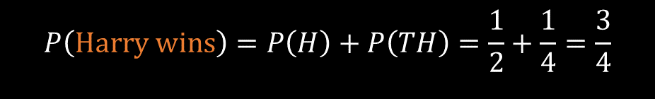
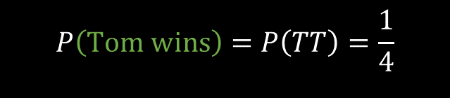
1st Flip
2nd Flip
3rd Flip
4th Flip
5th Flip
If we assign probabilitiess to each branch we can determine the chance of each outcome occurring:
H
H
H
T
T
H
H
T
Future Flips | Probability | Winner
H | ½ | Harry
TH | ½ x ½ = ¼ | Harry
TT | ½ x ½ = ¼ | Tom
H
H
T
T
T
H
H
½
T
H
H
H
½
T
½
T
H
T
½
T
H
H
T
T
Therefore:
T
H
T
H
H
$$P\left(Harry wins\right)=P\left(H\right)+P\left(TH\right)=\frac{1}{2}+\frac{1}{4}=\frac{3}{4}$$
H
T
T
H
H
T
$$P\left(Tom wins\right)=P\left(TT\right)=\frac{1}{4}$$
H
H
T
T
T
H
T
T
H
H
And the fairest way to split the $100 prize would be:
H
T
T
H
T
T
Harry = ¾ x 100 = $75
Tom = ¼ x 100 = $25
H
H
T
T
T
H
T

Slide 16
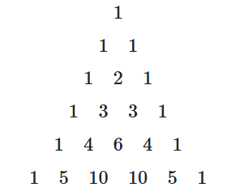
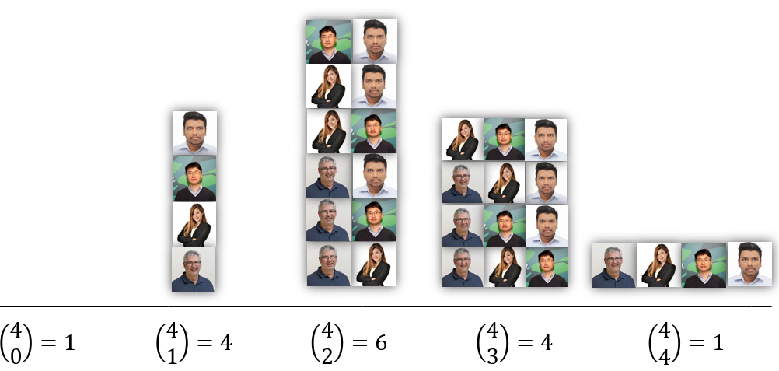
Pascal’s Triangle

Slide 17
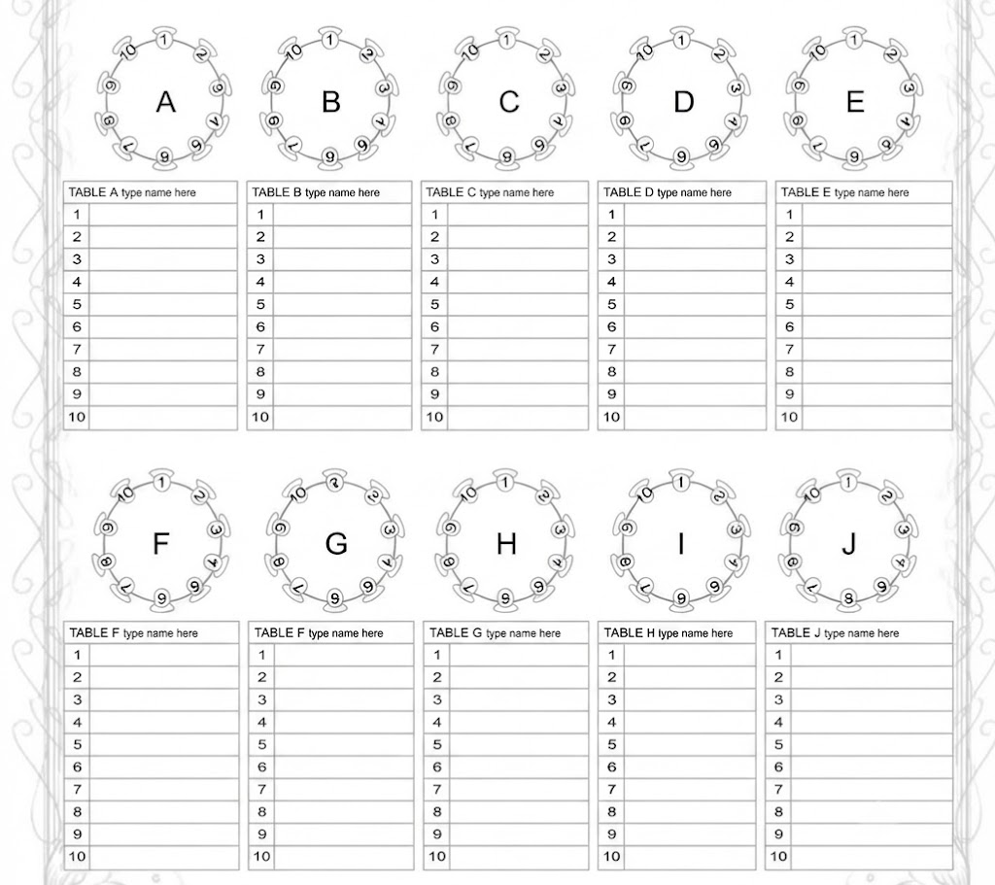
Possible arrangements for a wedding reception
Uncle Barry cannot sit near the bar because he becomes argumentative after several drinks
Sue’s divorced parents must be placed at separate tables, with neither table appearing more important than the other.
Aunt Susan should not sit with Cousin Rachel because Susan repeatedly asks when Rachel is going to have children.
Uncle Frank and Uncle Peter cannot sit together because they still argue about money borrowed in 2009.
Grandma June needs to sit close to the toilets and away from the speakers because she has difficulty walking and dislikes loud music.
…
The best man and maid of honour should sit near the newly married couple, but they should not sit beside each other because their partners are both the jealous type.

Slide 18




Possible arrangements for a wedding reception
$$\left(\begin{matrix}100 \\ 10\end{matrix}\right)=\frac{100!}{10!\left(100−10\right)!}$$
$$\left(\begin{matrix}4 \\ 0\end{matrix}\right)=\frac{100!}{10!×90!}$$
$$\left(\begin{matrix}4 \\ 0\end{matrix}\right)=\frac{100×99×98×97×96×95×94×93×92×91×90!}{10!×90!}$$
$$\left(\begin{matrix}4 \\ 0\end{matrix}\right)=\frac{62,815,650,955,529,472,000}{3,628,800}$$
$$\left(\begin{matrix}4 \\ 0\end{matrix}\right)=17,310,309,456,440$$

Slide 19
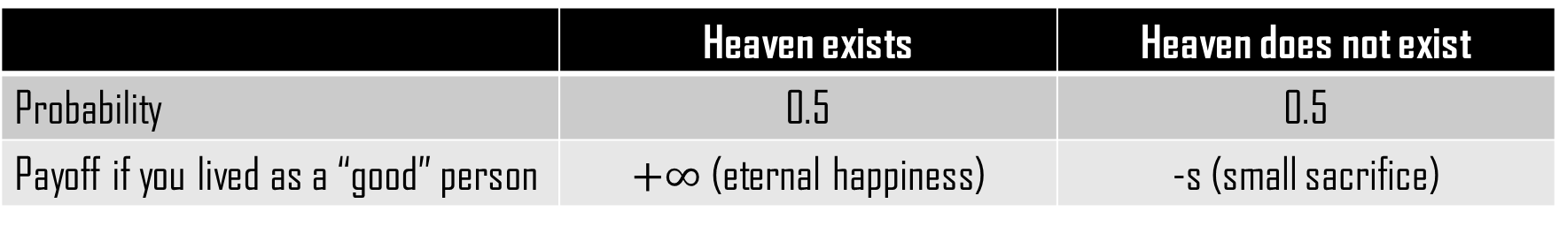

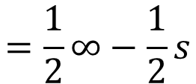
Pascal’s Wager – Expected Value
 | Heaven exists | Heaven does not exist
Probability | 0.5 | 0.5
Payoff if you lived as a “good” person | $+∞$ (eternal happiness) | -s (small sacrifice)
$$E=\left(P_{1}×V_{1}\right)+\left(P_{2}+V_{2}\right); where P=Probabilities and V=Value$$
$$E\left(\text{′}\text{good}′ person\right)=\left(0.5\right)×\left(∞\right)+\left(0.5\right)×(−s)$$
P(heaven exists)
Gain
P(heaven doesn’t exists)
Small loss
$$=\frac{1}{2}∞−\frac{1}{2}s$$
$$=∞$$

Slide 20

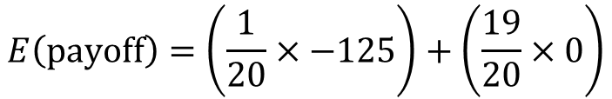

Parking Ticket - Expected Value
 | Fine | No Fine
Probability | 1/20 | 19/20
Payoff if you don’t pay for parking | -$125 | $0
Payoff if you do pay for parking | -$5.50 (certain) | -$5.50 (certain)
Expected Cost of NOT Paying
Expected Cost of Paying
<
$$E\left(payoff\right)=\left(\frac{1}{20}×−125\right)+\left(\frac{19}{20}×0\right)$$
$$E\left(payoff\right)=−\$5.50$$
$$E\left(pay\right)=−\$6.25$$

Slide 21
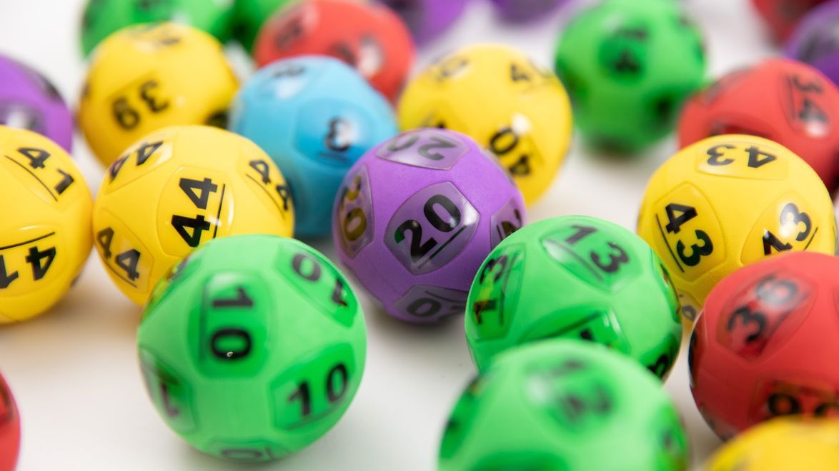



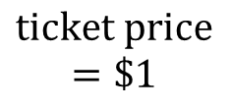

Australian Lottery - Expected Value
$$\left(\begin{matrix}44 \\ 6\end{matrix}\right)=\frac{44!}{6!\left(44−6\right)!}$$
$$\left(\begin{matrix}4 \\ 0\end{matrix}\right)=7,059,052$$
$$E\left(value of ticket\right)=\frac{27900000}{7059052}$$
<
$$ticket price$$
$$=\$1$$
$$E\left(value of ticket\right)≈\$3.95$$

Slide 22
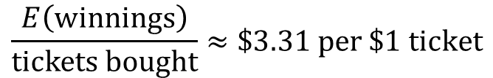
Australian Lottery - Expected Value
Outcome | Frequency | Probability | Share of pot | Payoff
One winner | 120 / 170 | .706 | Full pot | $27.9 million
Two winners (split half) | 40 / 170 | .235 | 1/2 pot | $13.95 million
Three winners (split three ways) | 10 / 170 | .059 | 1/3 pot | $6.98 million
$$E\left(winnings\right)=\left(\frac{120}{170}×27.9M\right)+\left(\frac{40}{170}×13.95M\right)+\left(\frac{10}{170}×6.98M\right)≈\$23.4M$$
$$\frac{E\left(winnings\right)}{tickets bought}≈\$3.31 per \$1 ticket$$

